Slide 1


GLOBAL ACADEMY OF TECHNOLOGY DEPARTMENT OF COMPUTER SCIENCE AND ENGINEERING (Accredited by NBA 2019-2022) Academic Year : 2019 - 20 ODD Sem
Subject Name | Project Work | Subject Code | 15CSP78
Student Name | PRAVEEN V | USN | 1GA16CS101
 | YASHAS C R |  | 1GA16CS182
 | THEJASVEE M |  | 1GA16CS195
 | SNEHA SURENDRA |  | 1GA16CS198
Domain | DEEP LEARNING | Group No: | 53
Project Title | “EXPERT SYSTEMS FOR DIFFERENTIAL DIAGNOSIS USING DEEP LEARNING ”
Under taken at | GLOBAL ACADEMY OF TECHNOLOGY
Guide Name | JYOTHI R

Slide 2
Agenda
Introduction
Literature Survey
Motivation
Existing System
Problem statement
Requirements Specification
Bibliography

Slide 3
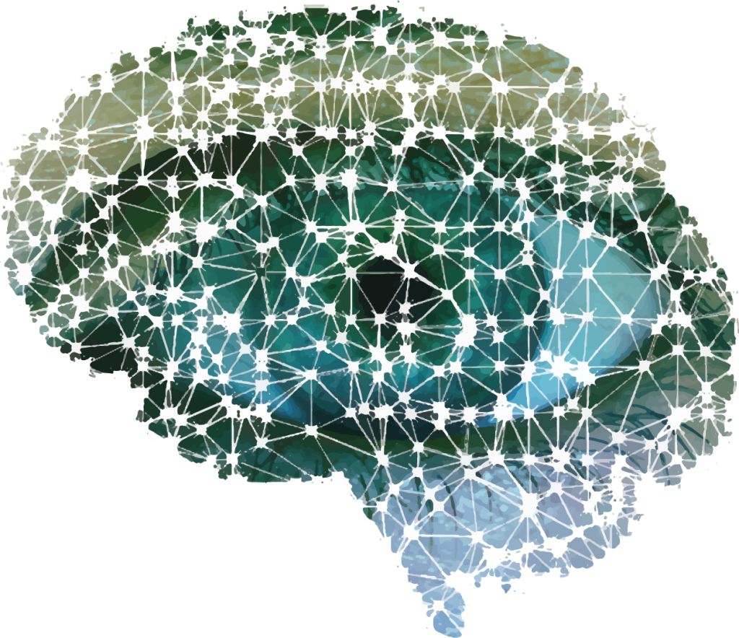
Introduction to Domain
Artificial Intelligence.
Deep Learning: Subset of Machine Learning
Benefits of Deep Learning over Machine Learning.
Neural network helps in understanding the underlying relationships among the symptoms and map it to the most probable diseases.
How the structure of neuron is implemented in the algorithm.

Slide 4
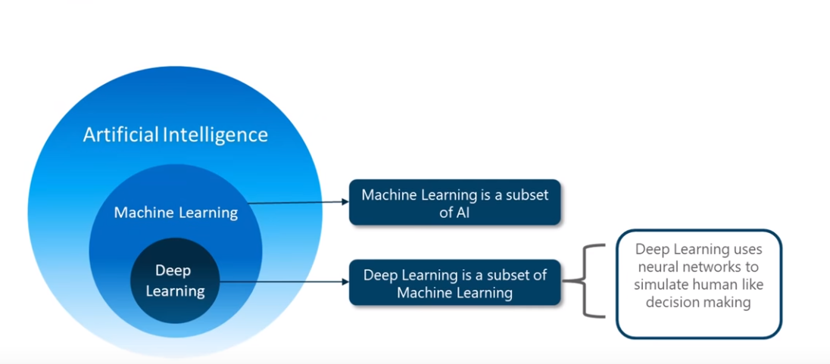

Slide 5
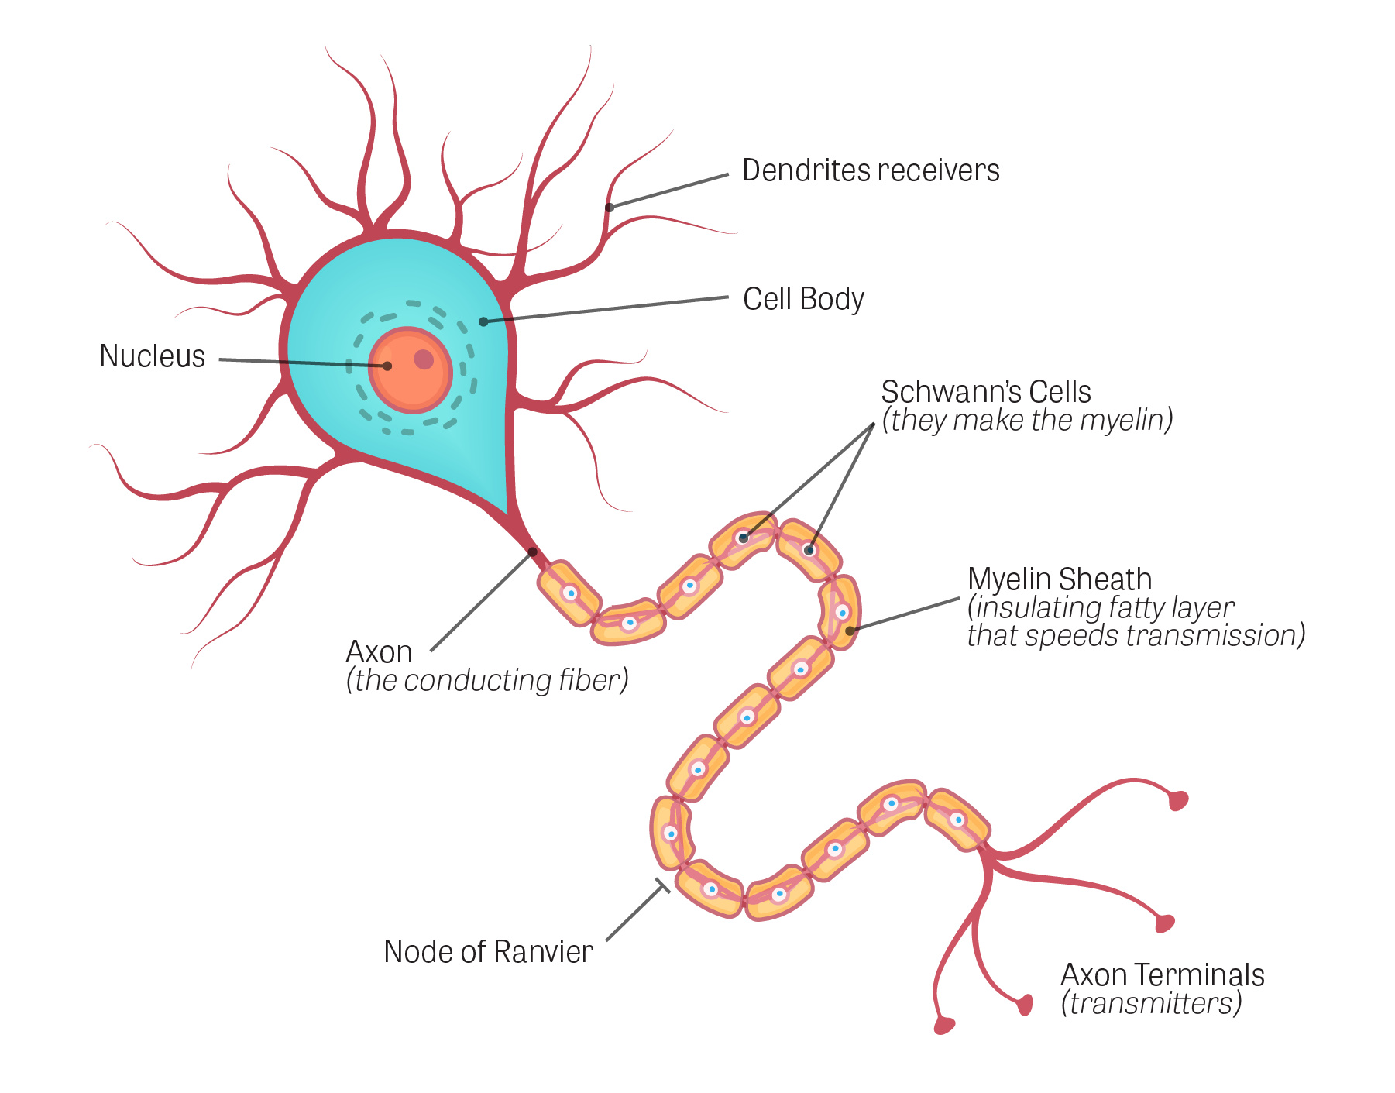
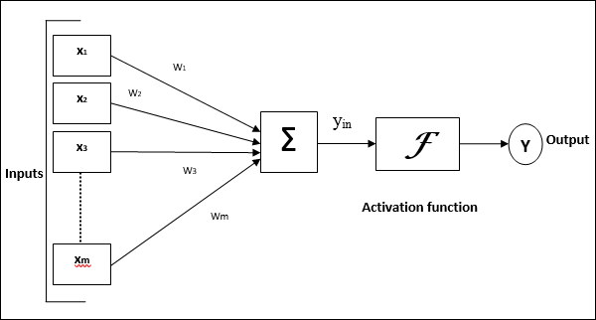

Slide 6
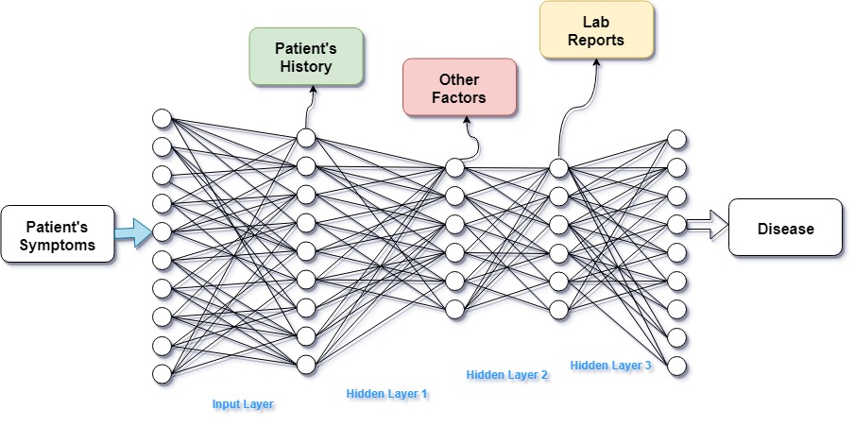

Slide 7
Base Paper :- “Medical Diagnosis System using Machine Learning”
Literature Survey:
Description:
Objective is to design an automated medical decision making system and help doctors in minimizing misdiagnosis.
Database for a specific disease and related symptoms is created.
Later proposed an algorithm to predict the Swine Flu disease on several attributes.
Advantages:
They have observed the outcomes for machine learning algorithms such as Bayesian classification, Decision Tree, and compared it with the neural networks algorithms such as dynamic node creation(DNC) and feed-forward neural network construction.
The system is more reliable and faster than the conventional systems.
Disadvantage:
The problem statement only focuses on a single disease i.e. Swine Flu .
Each disease will have to have its on algorithm to be precise and accurate.

Slide 8
Paper 2: “From expert systems to machine-learned diagnosis model”
Description:
This paper presents a method to merge both approaches by using expert systems as generative models that create simulated data on which models can be learned.
Demonstrates that such a learned model not only preserves the original properties of the expert systems but also addresses some of their limitations.
This show how this approach can also be used as the starting point to combine expert knowledge with knowledge extracted from other data sources, such as electronic health records.
Advantages:
It includes the relationship between expert systems and simulated data.
The extraction of data from the knowledge base to obtain the learning data.
Disadvantages:
This model will give the best output only for diagnosing simple diseases and cannot learn on its experiences.
The accuracy of this model drops considerably while diagnosing complex diseases.

Slide 9
Paper 3:- “Machine Learning applied to the detection of retinal blood vessels”
Description:
This paper details the process and results of an attempt to improve upon the accuracy of retinal image segmentation to aid doctors in diagnosing diseases of the eye using supervised (support vector machine) and unsupervised (modified k-nearest neighbor) machine learning algorithms.
Advantages:
Simplifies the method of determining the segmentation of the circulatory system in the eye as it is difficult for doctors as the task of distinguishing blood vessels by simply observing retinal images has proven to be challenging.
It is capable of detecting wide range of diseases using several morphological features of retinal veins and arteries.
Disadvantage:
The implementation of the model is done using only two algorithms i.e. SVM and modified KNN.
Will be able to diagnose only those diseases that can be detected using retinal scans .

Slide 10
Paper 4:- “A Study on Machine Learning algorithm in medical diagnosis”
Description:
The main objective is to design a medical diagnosis software using Machine Learning algorithms.
The algorithms used are Support Vector Machine, Naïve Bayesian, Random Forest etc.
Advantages:
The paper covers the ML algorithms used for several diseases such as diabetes, liver failure, autism identification, heart problems, etc.
It is completely data driven and have the capability of examining the large amount of data.
These algorithms are more accurate and does not prone to errors.
Disadvantage:
The statistical models cannot handle categorical data with missing values and large data points.

Slide 11
Paper 5:- “Application of Neural Networks in Early Detection and Diagnosis of Parkinson's Disease”
Description:
This paper proposes a method in early detection and diagnosis of PD by using the Multilayer Feedforward Neural Network (MLFNN) with Back-propagation (BP) algorithm.
The dataset information used in this study was taken from the Oxford Parkinson’s Disease Detection Dataset and the output of the network is classified into healthy or PD by using K-Means Clustering algorithm
The performance of this classifier was evaluated based on the three parameters; sensitivity, specificity and accuracy.
Advantages:
The result shows that network can be used in diagnosis and detection of PD due to the good performance
ROC graph is used to assess the performance of a classifier. It is a useful and clear possibility for organizing classifiers and measuring their performance
Disadvantage:
The attributes used in this research are related only to the frequencies of voice.
Notes:
improve how: only single hidden layer is used, whereas we use multiple hidden layer

Slide 12
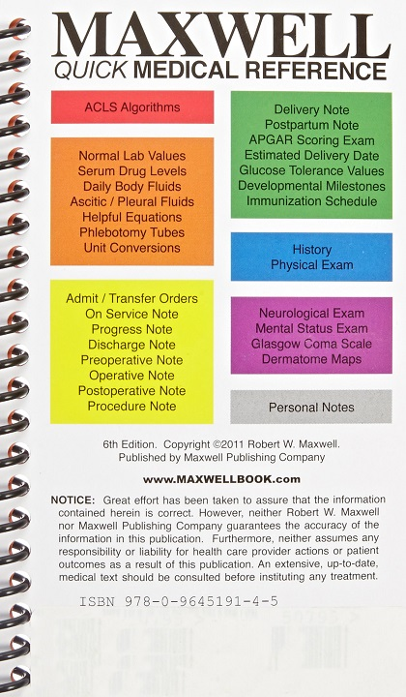

Existing System
QMR:- Quick Medical Reference acts as an information tool, providing users with multiple ways of reviewing and manipulating the diagnostic information in the program's knowledge base.It can be viewed as an electronic textbook of medicine.
Dxplain:-DXplain is a decision support system which acts on a set of clinical findings (signs, symptoms, laboratory data) to produce a ranked list of diagnoses which might explain the clinical manifestations. DXplain provides justification for why each of these diseases might be considered, suggests what further clinical information would be useful to collect for each disease.

Slide 13
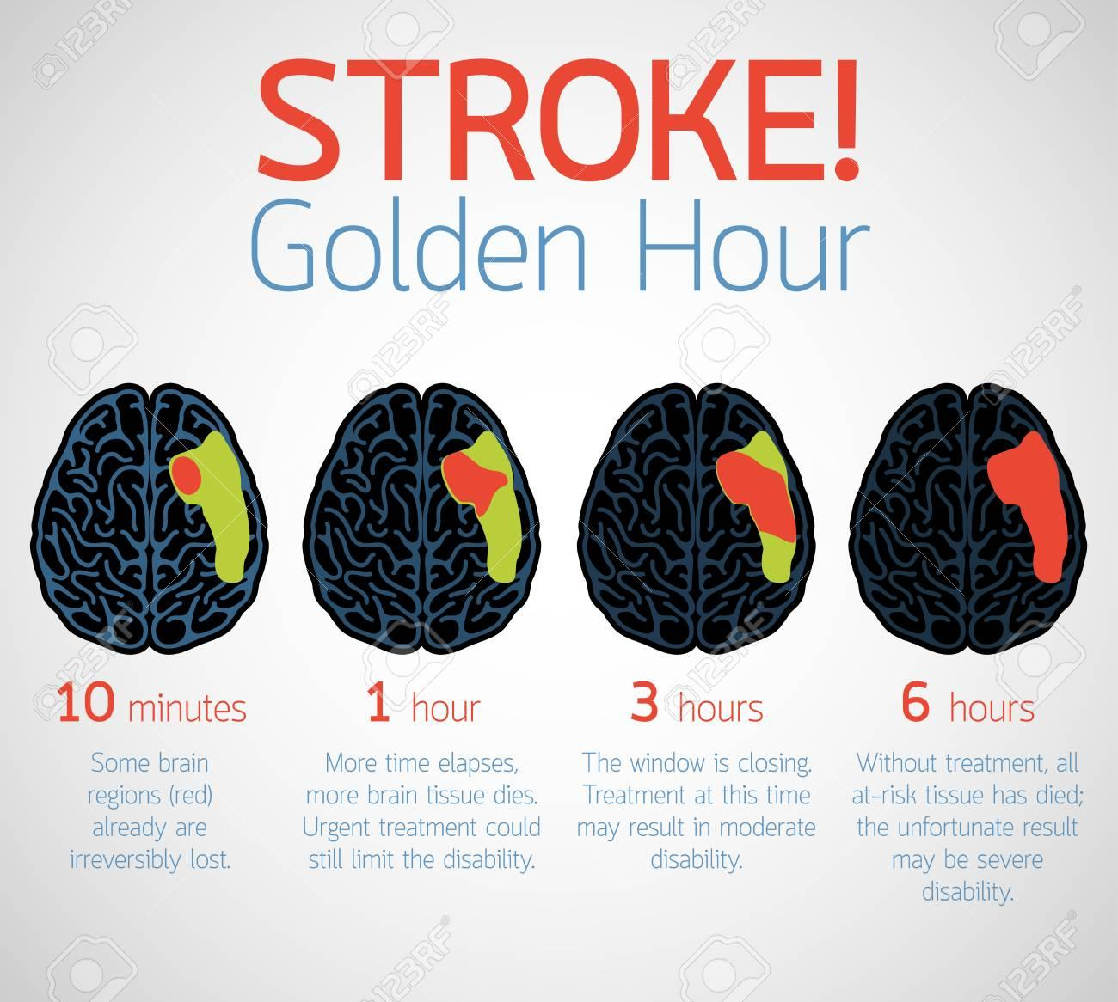
Motivation
The poor rate of diagnosing, finding the accurate disease and commencing the treatment.
Negative impact on diagnosis due to the lack of knowledge and loss of information.
Utilizing the golden hours for diagnosing rather on treatment.

Slide 14

Problem Statement
Develop an automated diagnosing system for patients provided with the patient’s conditions, test results and history and listing out accurately the most appropriate diseases causing the symptoms which can improve the rate of diagnosing drastically, increase the probability of permanent cure and thus saving millions of life.

Slide 15
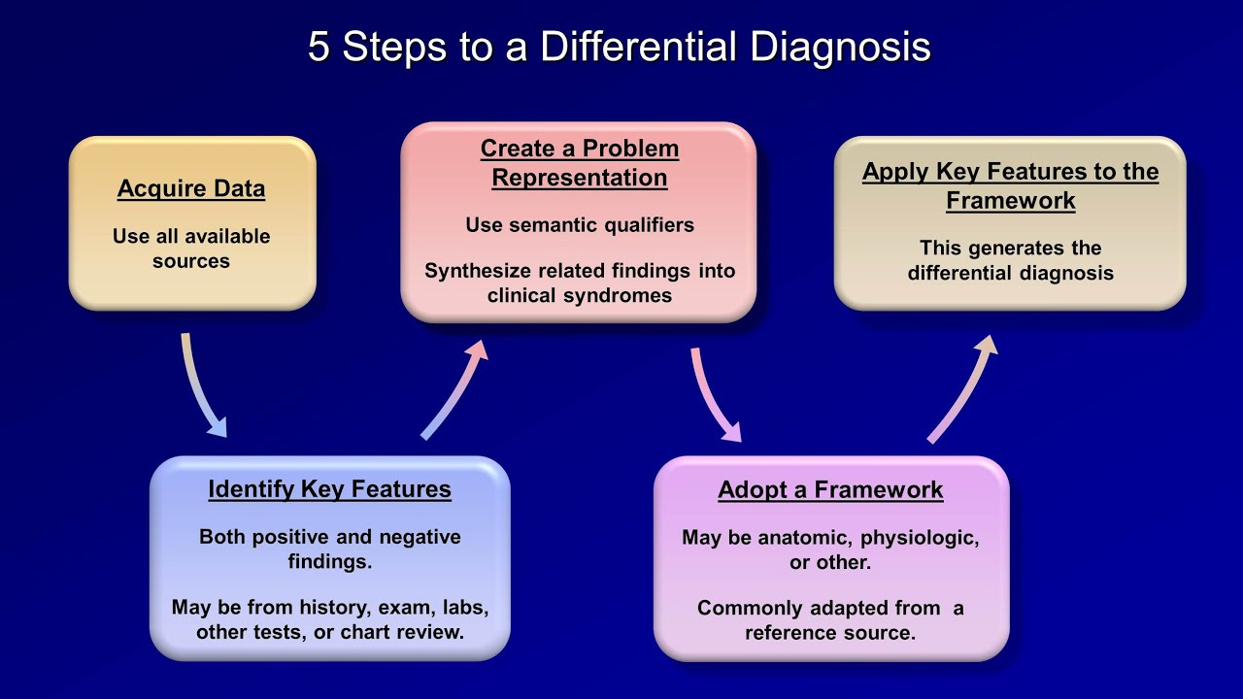
Design:

Slide 16
Requirements Specification
Hardware Components:
PC with 8gb RAM
i7 processor
50GB HDD
Software Requirement:
Windows 10
Python
Anaconda
Jupyter Notebook
Tensorflow
Keras

Slide 17
Bibliography
[1] Murali Ravuri, Anitha Kannan, “From expert system to machine-learned diagnosis models, Proceedings of Machine Learning Research , Machine Learning for Healthcare,85,1–16, 2018.
[2] Dhaval Raval, Dvijesh Bhatt, “Medical diagnosis system using Machine Learning, International Journal of computer science , Machine Learning for Healthcare, Volume 7,1–6, 2016.
[3]Dr A N Jayanthi, Ms D Pavithra, “A Study On Machine Learning Algorithm In Medical Diagnosis”, International Journal of Advanced Research in Computer Science, Volume 9,No 4, 2018.
[4] Shaik Razia,N Vamsi Krishna,”A Review On Disease Diagnosis Using Machine Learning Techniques” , International Journal of Pure and Applied Mathematics, Volume 117 No. 16 2017, 79-85.
[5] Alex Yee,” Machine Learning Applied to the Detection of Retinal Blood Vessels, Stanford University.

Slide 18

Thank You

